Slide 1

Get your food with
RecipeLab
PRESENTED BY MIRZO ULUGBEK RUSTAMOV

Slide 2


INTRODUCTION
Goal: Help users quickly find recipes by uploading ingredient photos
This app aims to reduce food waste and simplify cooking by recognizing ingredients in photos and recommending recipes.

Slide 3

WHO NEEDS IT
Anyone who wants to cook at home
Anyone who has limited time to cook
Anyone who wants to control what they eat
Anyone who doesn’t want to go
to grocery store just before cooking

Slide 4

USER PERSONA
Jake Thompson is a 21-year-old college student living on a tight budget. Between classes and part-time work, he doesn’t have much time or experience in the kitchen. He wants to cook simple, affordable meals using what he already has at home, but often feels overwhelmed by long recipes and unfamiliar ingredients.
Name: Jake Thompson
Age: 21
Goal: Cook affordable meals, avoid waste
Pain Points: Limited cooking skills, long recipes

Slide 5
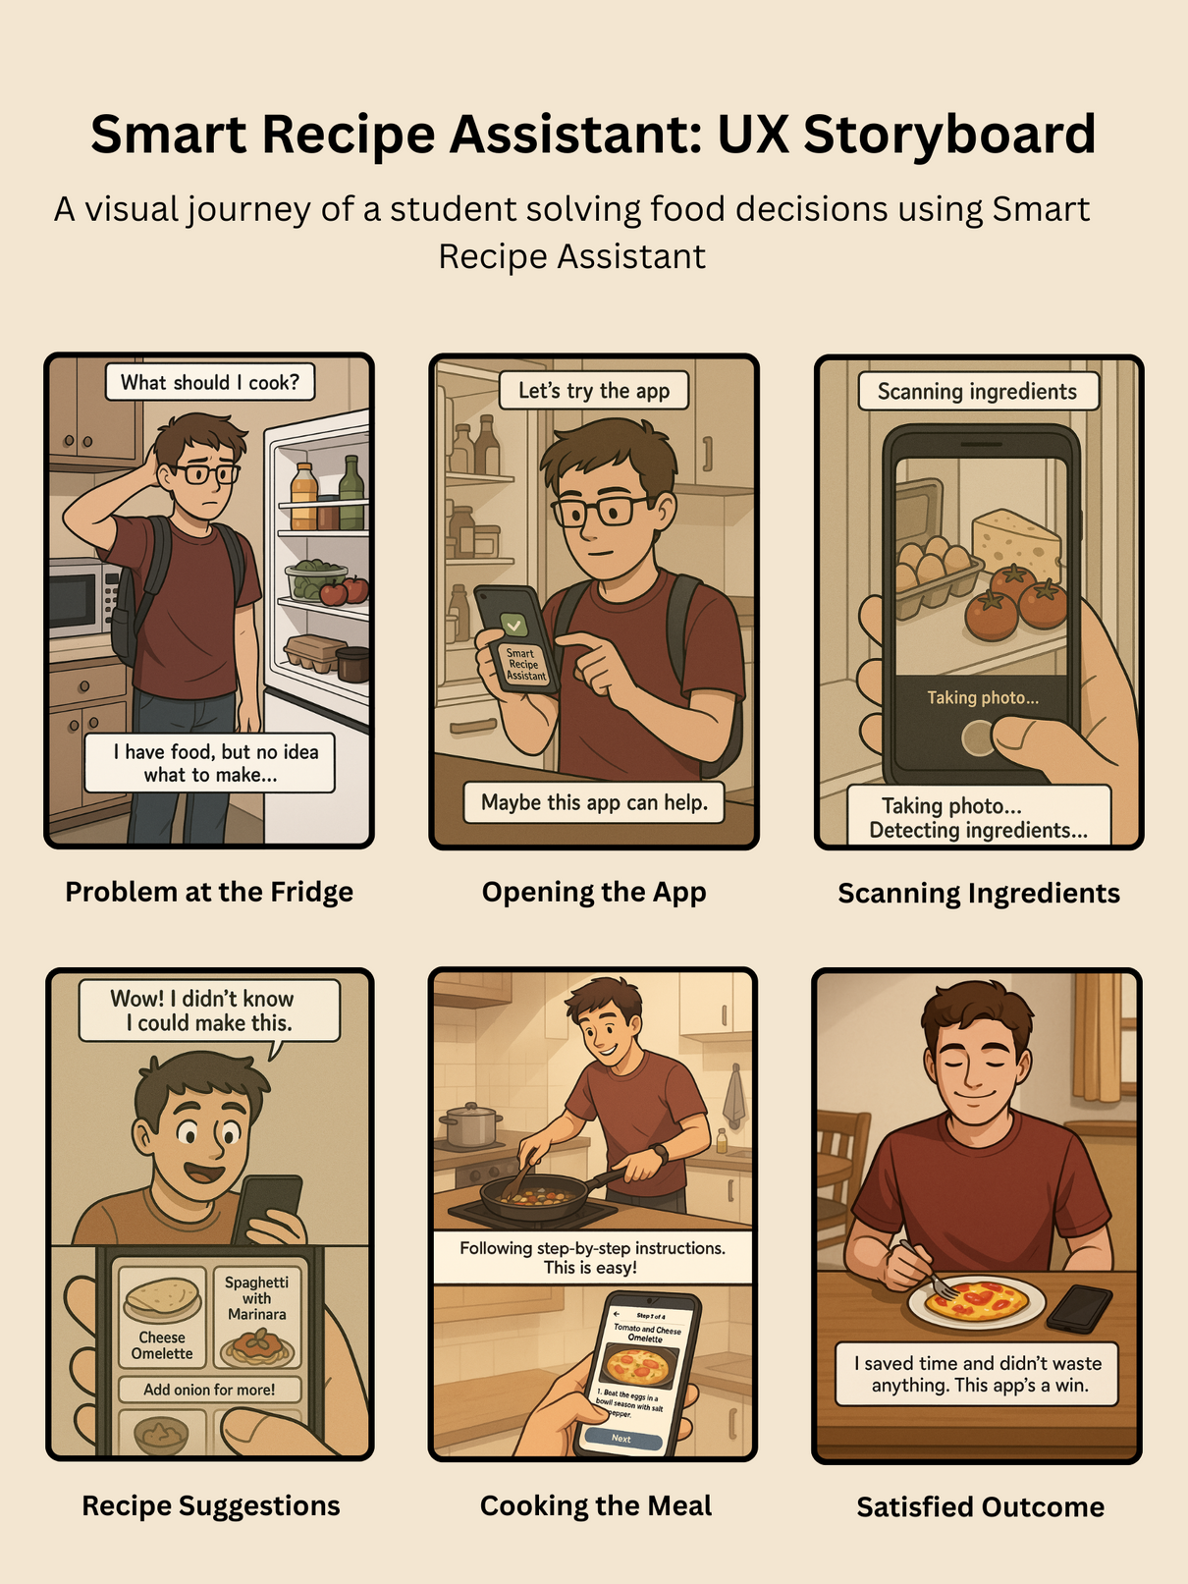
STORYBOARD

Slide 6
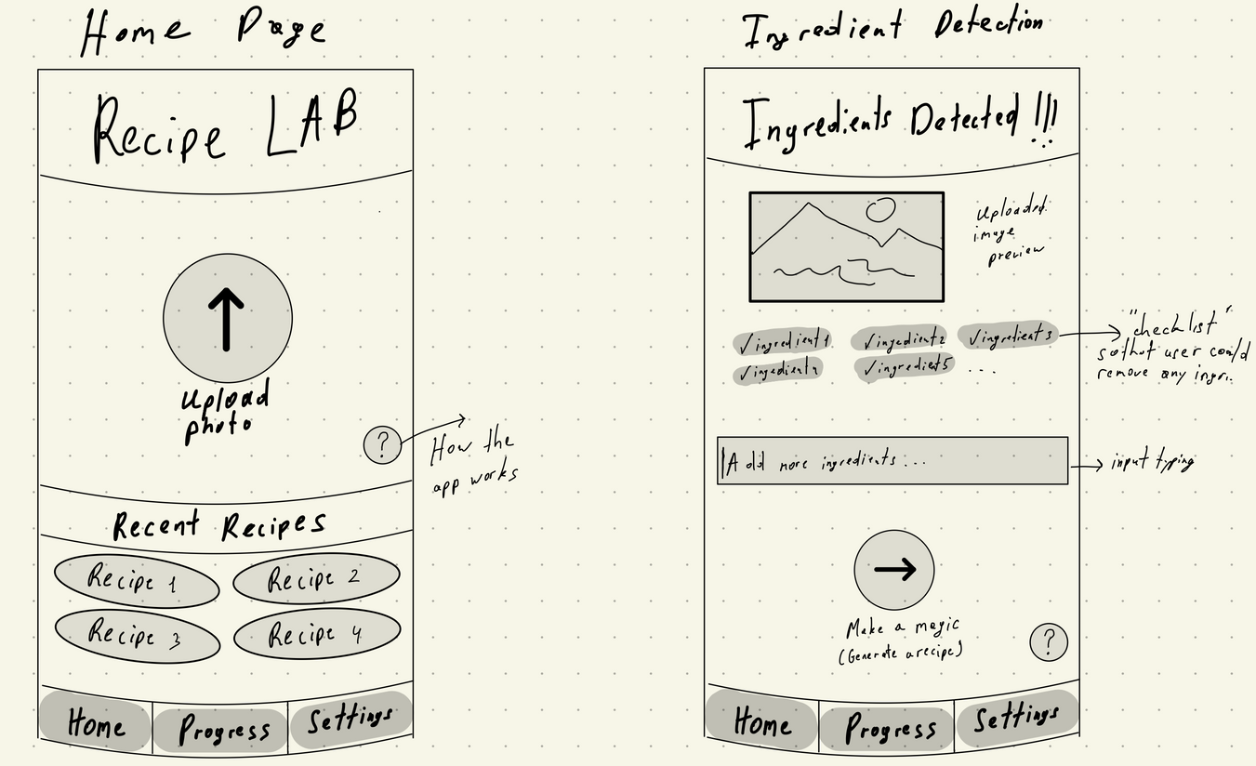
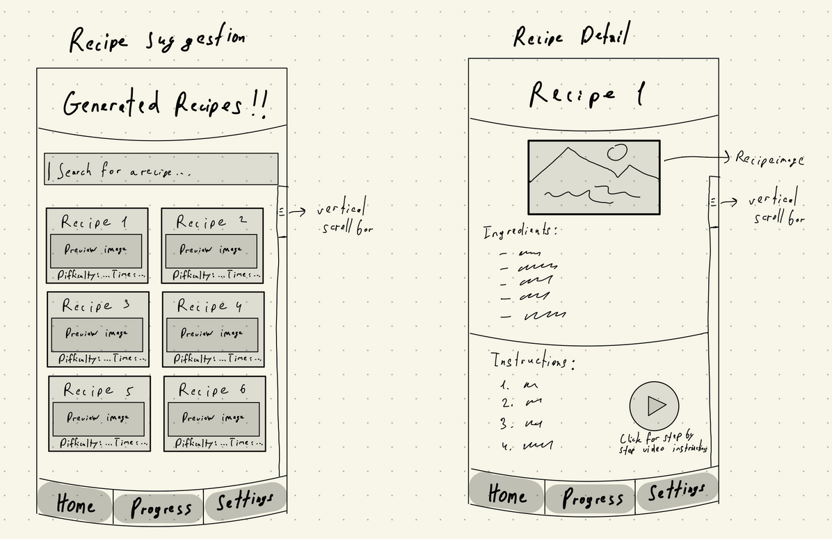
WIREFRAMES

Slide 7
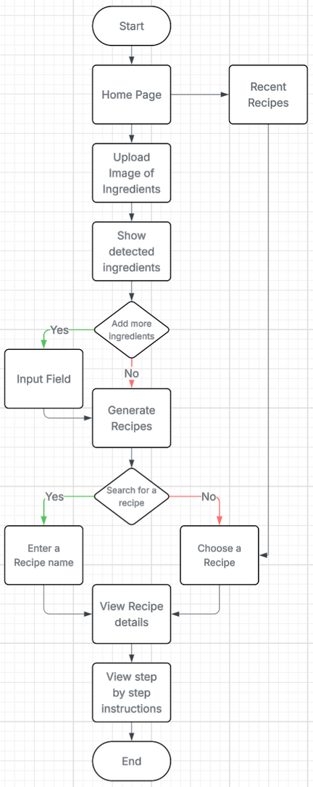
INITIAL USER FLOW

Slide 8
USER INTERVIEW WITH SANAAN FAYAZ WANI
1. What do you like most about the RecipeLab?
Answer: It helps me decide what to cook using what I already have. The image upload and recent recipes features are really convenient.
2. What features would make the recipe suggestions more useful for you?
Answer: Filters like "vegetarian" or "under 30 minutes" would be great. A "save for later" option would also help.
3. How do you feel about the app’s interface and navigation?
Answer: It’s clean and easy to use. Buttons are big and clear—nothing feels confusing.
4. Is the overall user flow intuitive for you?
Answer: Yes, it flows naturally from image upload to recipe suggestions. No tutorial needed.
5. How helpful is the “recent recipes” section?
Answer: Very helpful—it saves time and helps me remember dishes I’ve made. Showing the last used date could improve it.
6. How does this app compare to other recipe apps you’ve used?
Answer: It feels more personal and smart. Other apps just list recipes, but this one thinks for you.
7. Any suggestions for new features or improvements?
Answer: A quick tutorial for new users and voice input for ingredients would be useful.

Slide 9
FEEDBACK IMPACT
Added recipe filters (e.g., “under 30 min”)
Enlarged buttons and clarified navigation
Included a recent recipe section for easy recall
KEY QUSTIONS
What would make you use this app regularly?
What confuses you most in recipe apps?
What features are must-haves?

Slide 10
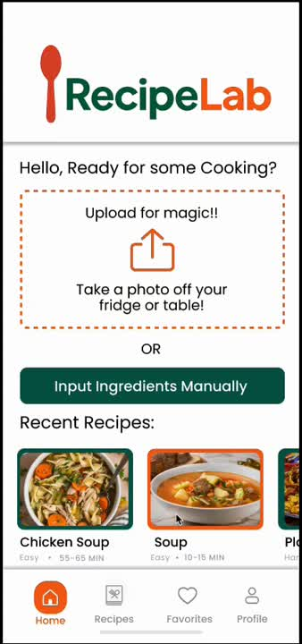
DEMO VIDEO

Slide 11
CHALLENGES
Designing intuitive interactions with minimal onboarding
Avoiding feature overload while keeping the app helpful
Applying feedback without cluttering the design
LIMITATIONS
Lacks full accessibility support
Ingredient detection accuracy not verified in UX phase
English-only interface

Slide 12


Have questions? Reach out.
Mirzo Ulugbek Rustamov
813-325-3118
mrustamov@usf.edu

